Slide 1






PDS
Computer Vision
MPLS VPN &
Border Gateway protocol (BGP)
BGP message with Wireshark on GNS3
@ P. Siagian
Border Gateway protocol (BGP)
https://github.com/siagianp
https://www.youtube.com/@AmelOline/videos
https://github.com/amelcharolinesgn2/IoT_simulator-mqtt-NodeRed
https://github.com/amelcharolinesgn2/Cloud-Infrastructures
https://github.com/amelcharolinesgn2/ClouD-Infrastructure-SISKA-2025
https://github.com/amelcharolinesgn2/Gyroscope-Sensor-Data-Accelerometer
Notes:
https://github.com/Rakibul73/Cisco_Network_Routing_Switching
https://github.com/Rakibul73/Cisco_Network_Routing_Switching/tree/main/Problem_Lab_BGP
https://networklessons.com/labs/bgp-professional-lab-1#BGP_Prefer_eBGP_over_iBGP
https://github.com/Rakibul73/whiteboard-app

Slide 2
MPLS BGP VPN
Multi-Protocol Label Switching
Notes:
Lab #2 Two LANs connected by a router
http://wpage.unina.it/rcanonic/didattica/gns3-labs/lab2/
Lab #16 MPLS with static Label Switched Path (LSP)
http://wpage.unina.it/rcanonic/didattica/gns3-labs/lab16/
https://www.quisted.net/index.php/2018/04/30/lab-viii-mpls-mp-bgp-eompls/
https://blog.pierky.com/gns3-lab-bgp-multihoming-to-a-single-provider-with-partial-routing/

Slide 3
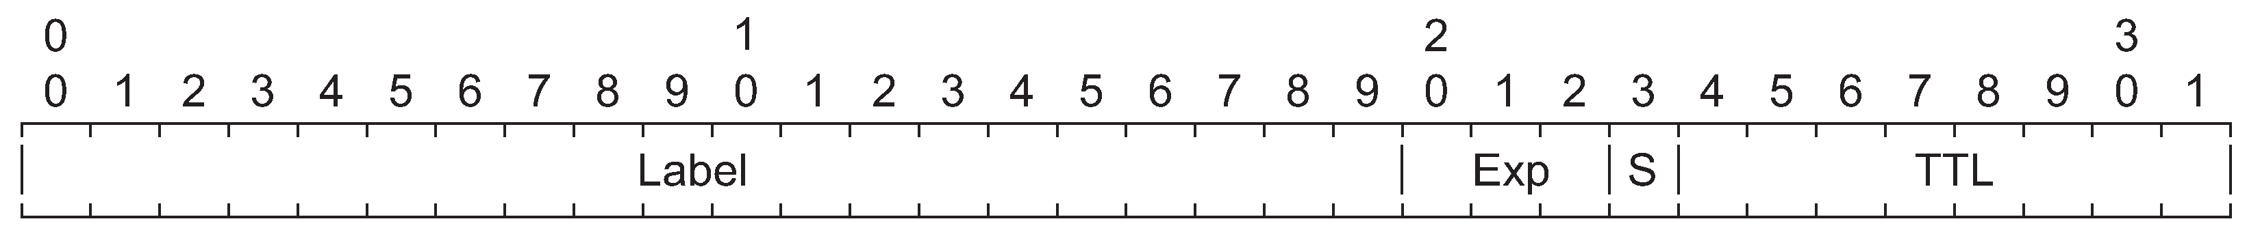
MPLS with static Label Switched Path (LSP)
Multiprotocol Label Switching (MPLS) is a routing technique that allows moving data from one node to the next based on external labels rather than destination IP addresses. Packets are routed along pre-established Label Switched Paths (LSPs).
Label Switch Routers (LSR), located in the inner part of an MPLS network, forward packets based on MPLS labels.
Label Edge Routers (LER), located at the edge of an MPLS network, encapsulate IP packets by adding the MPLS header (push operation) to traffic coming from adjacent routers external to the MPLS network and decapsulate IP packets by removing the MPLS header (pop operation) from traffic coming from adjacent MPLS routers.
In MPLS, packets can carry multiple labels in a stack. An LSR can swap the label at the top of the stack, pop the stack, or swap the label and push one or more labels into the stack. The processing of a packet is always based on the top label.
As described in RFC 3032, MPLS Label Stack Encoding, the label stack is represented as a sequence of label stack entries. Each label stack entry consists of 4 octets comprising a 20-bits label field. Hence, the maximum label value is 1048575. The S bit, if 1, marks the last entry of the label stack (Bottom of Stack). create a static LSP in an MPLS network consisting of two LERs and a single LSR. Packets towards host H5 are labeled by LER R1 with label 100. The intermediate LSR R2 swaps label 100 into label 200 and forwards packets to the LER R3 which, in turn, pops the label and delivers the packets to the destination H5.
For packets generated by H5, the LER R3 encapsulates them with label 300. The intermediate LSR R2 swaps label 300 into label 400 and delivers the packets to the LER R1. Finally, R1 pops the MPLS label and delivers the packets to the destination H4
As described in RFC 3032, MPLS Label Stack Encoding, the label stack is represented as a sequence of label stack entries. Each label stack entry consists of 4 octets comprising a 20-bits label field. Hence, the maximum label value is 1048575. The S bit, if 1, marks the last entry of the label stack (Bottom of Stack). create a static LSP in an MPLS network consisting of two LERs and a single LSR. Packets towards host H5 are labeled by LER R1 with label 100. The intermediate LSR R2 swaps label 100 into label 200 and forwards packets to the LER R3 which, in turn, pops the label and delivers the packets to the destination H5.
For packets generated by H5, the LER R3 encapsulates them with label 300. The intermediate LSR R2 swaps label 300 into label 400 and delivers the packets to the LER R1. Finally, R1 pops the MPLS label and delivers the packets to the destination H4

Slide 4
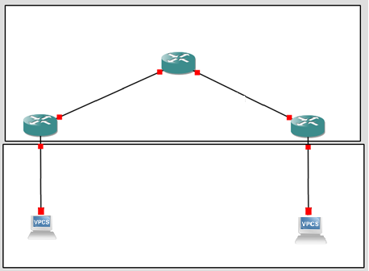
LSR
LSP: label 100
LSP: label 200
LSP: label 400
LSP: label 300
. 2
. 2
R2
10.0.1.0/30
LER
. 1
10.0.0.0/30
. 1
R1
R3
LER
. 1
. 1
192.168.1.0/24
192.168.2.0/24
e0
. 2
e0
. 2
H4
H5
Notes:
http://wpage.unina.it/rcanonic/didattica/gns3-labs/lab2/

Slide 5
BGP Message
Border Gateway protocol (BGP
BGP MPLS Layer 3 VPNs GNS3 Lab
MPLS L3 VPN
Cisco MPLS VPN Configuration Guide
Notes:
https://www.slideserve.com/hatten/lecture-7-l2-mpls-vpn-vpws-h-vpls-powerpoint-ppt-presentation

Slide 6
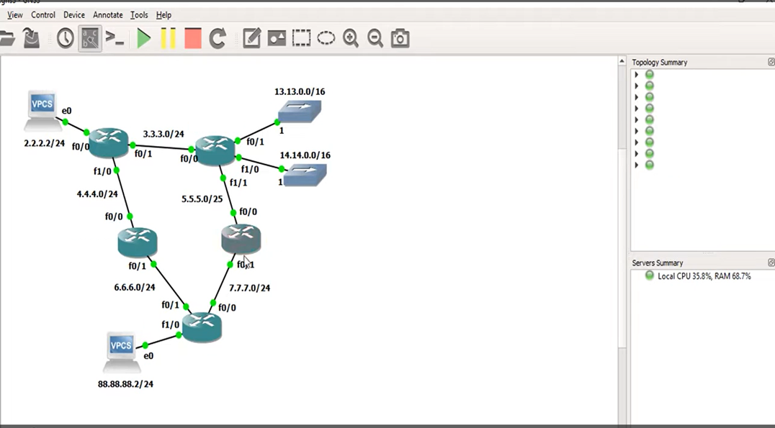
Cisco.net
SGB-600
BLG-700
AMA-AS200
13.13.0.0/16
14.14.0.0/16
Cisco.net
L3-AS_100
ISP-901
L3-AS_100
AMA-AS200
SBG-600
BLG-700
myVPCS.com
ISP-901

Slide 7
MPLS
(Multiprotocol Label Switching)
MPLS with static Label Switched Path (LSP)
http://wpage.unina.it/rcanonic/didattica/gns3-labs/lab16/
Notes:
http://wpage.unina.it/rcanonic/didattica/gns3-labs/lab16/

Slide 8
Konfigurasi autonomous system (AS), pembentukan neighbor (tetangga) EBGP/IBGP, dan advertising network
Pertukaran rute antar-jaringan berbeda, manipulasi jalur menggunakan atribut, dan verifikasi sesi

Slide 9
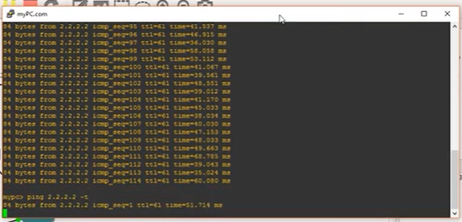
IP addres telah di configure BGP

Slide 10
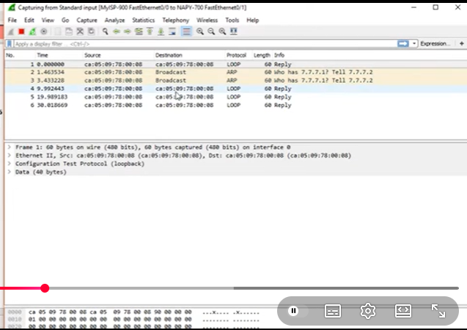
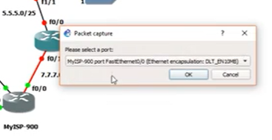
Run Wiresark
Kita adalah Admin dari My ISP
Kita adalah Admin dari My ISP
Start Capture

Slide 11
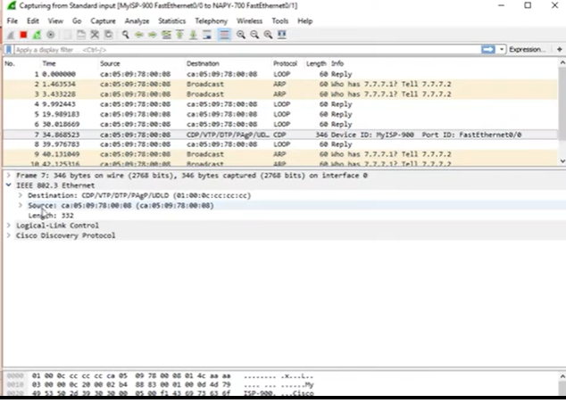
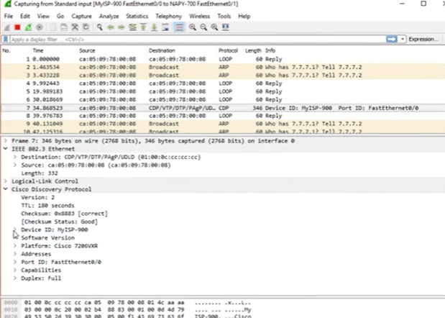
CDP

Slide 12
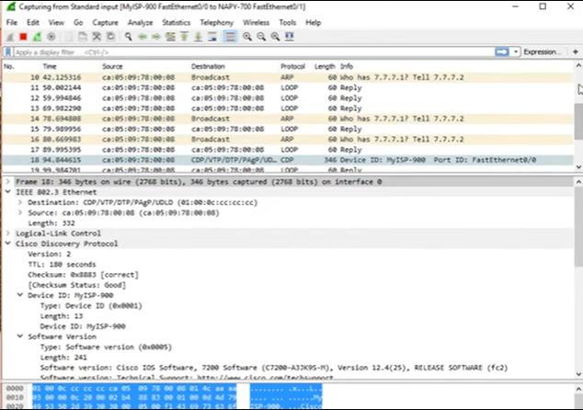
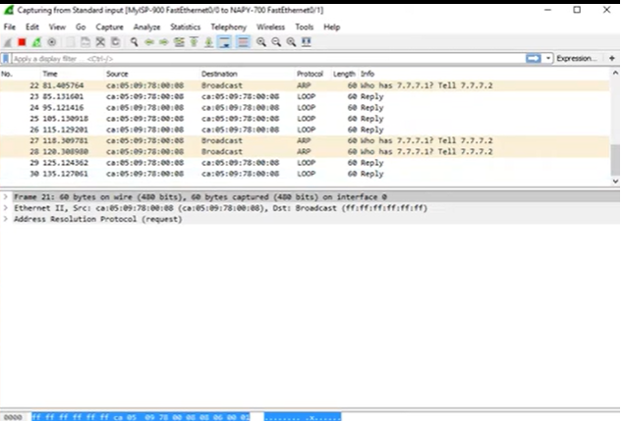
Int 0/0 no cdp
CDP ke cdp berikutnya : s3etiap 1 menit
Send mac address 7.7.7.1 tidak ketahuan

Slide 13
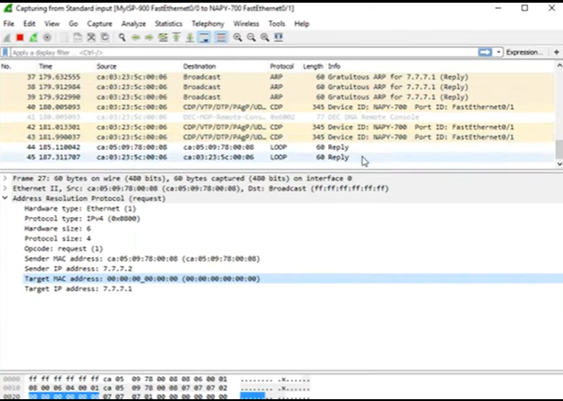
NAPY telah hidup
NAPY telah hidup

Slide 14
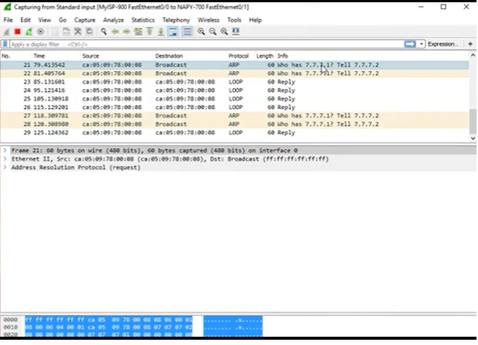
CDP
No CDP
Yang Tampil Packet ARP

Slide 15
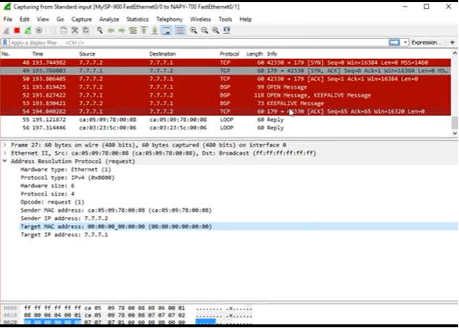
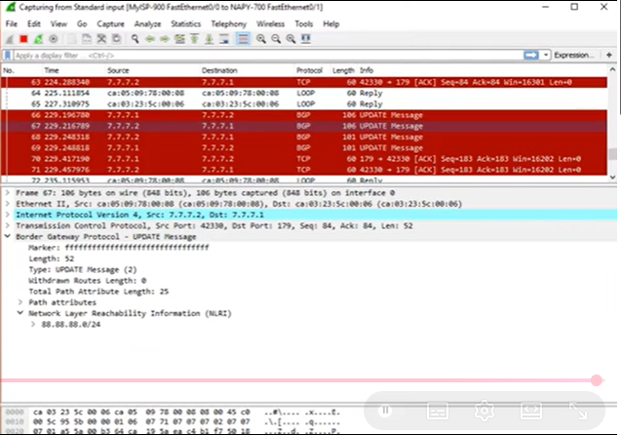
Aktifkan Router MKPY
771 send to 772

Slide 16
Gateway
Notes:
https://www.quisted.net/index.php/2018/04/30/lab-viii-mpls-mp-bgp-eompls/

